Slide 1
The Application of Satellite Field Integrator in GEO Grid to Enhance GEO Science Study
Sarawut NINSAWAT
GEO Grid Research Group/ITRI/AIST

Slide 2
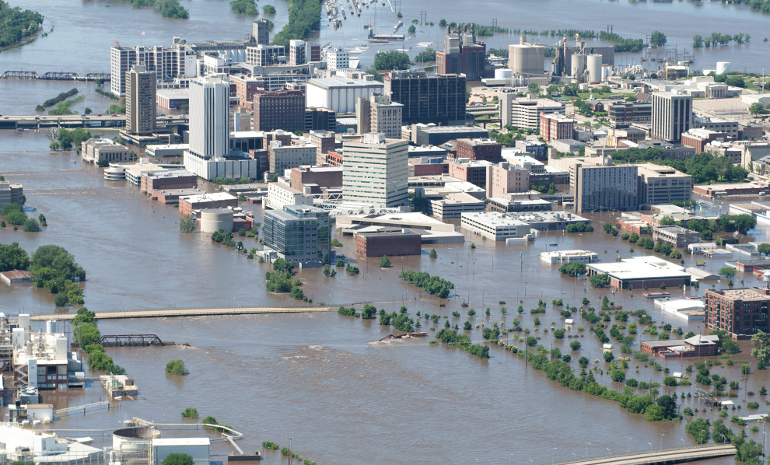
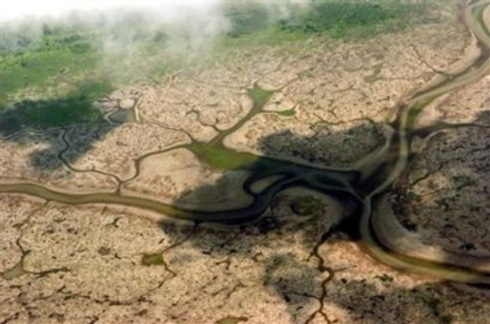
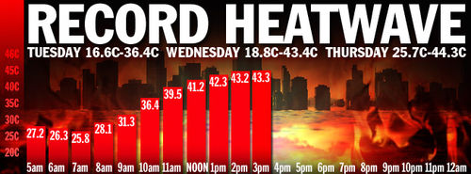
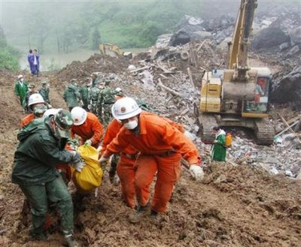
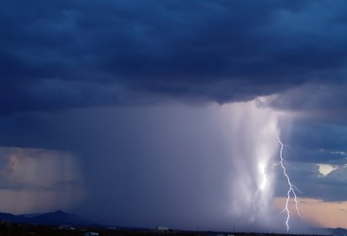
Environmental Monitoring
Large spatial coverage
Long time period observation
Up-to-date data

Slide 3
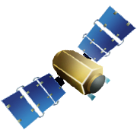



Geospatial Data Gathering
Satellite
Data Center
Field Survey
with Laboratory
Data Logger
Internet
Smart Sensor

Slide 4
Satellite RS & Ground-based
Benefit of satellite RS:
Cheap and rapid over large geographic area
Regional coverage and broadly spectral resolution
Continuous acquisition of data
Archive of historical data
Limitation of satellite RS:
Interference of atmospheric gaseous and particles
Absorbing (H₂0, O₃ etc.) and Scattering ( mainly by aerosol particles such as dust, ash and smoke)
Not direct sample of the phenomenon.
Ground-based observation:
Direct sample of the phenomenon is possible
Real-time or Near Real-time observation
High temporal resolution
Expensive for wide area observation

Slide 5
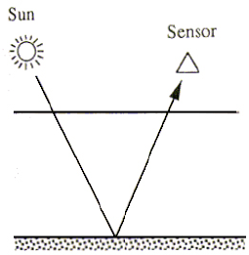
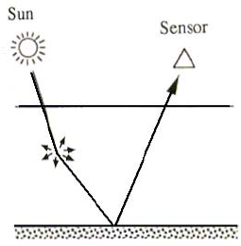
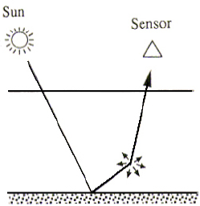
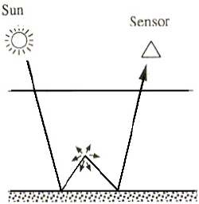
Surface reflectance and Top of the atmosphere
Image from: http://www.profc.udec.cl/~gabriel/tutoriales/rsnote/cp9/cp9-2.htm
Notes:
A portion of the light that reaches a sensor flying overhead actually comes from the Earth's atmosphere, not the surface of the Earth.
This signal from the atmosphere, which can obscure the signal emanating from the land or water of interest, is caused by molecular scattering and absorbing of gas and particles in the atmosphere.
Particles such as dust, ash, and smoke also scatter light reflected from the Earth's surface.

Slide 6

Satellite products
Basic Product
Top of the atmosphere
Surface Reflectance
Land Surface Temperature
Sea
Surface
Temperature
Higher Product
Gross Primary
Productivity
Chlorophyll A
Land Cover
Vegetation
Indices

Slide 7
Air Temperature
Air temperature near the Earth’s surface
Key variable for several environmental models.
Agriculture, Weather forecast, Climate Change, Epidemic
Commonly measure at 2 meter above ground
In most case, Spatial interpolation from sample point of meteorological station is carried out
Based on Land use, elevation etc.
Uncertainly spatial information available of air temperature is often present.
Limited density of meteorological station
Rarely design to cover the range of climate variability with in region

Slide 8
MODIS LST
MODIS Land Surface Temperature
Day/Night observation
Target accuracy ±1 K.
Derived from Two Thermal infrared band channel
Band 31 (10.78 - 11.28 µm)
Band 32 (11.77 – 12.27 µm)
Using split-window algorithm for correcting atmospheric effect
Not a true indication of “ambient air temperature”
However, there is a strong correlation between LST and air temperature
Evaluation of a correlation between the measured air temperature from meteorological station and LST can estimated air temperature.

Slide 9
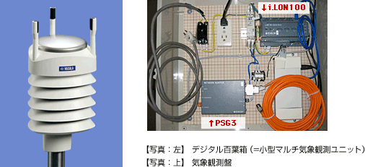
Weather Station : Live E! project
“Weather Station” is a the biggest available Sensor Network.
Live E! is a consortium that promotes the deployment of new infrastructure
Generate, collect, process and share “Environmental Information”
Accessible for Near/Real-time observation via Internet Connection
Air temperature
Humidity
Wind Speed
Wind Direction
Pressure
Rainfall

Slide 10
State of Problems
Lack of comprehensive framework that provides an estimated air temperature map from satellite remote sensing image with ease of use to the end-users.
Huge amount of effort from user such as
Prepare, analyze and process both of datasets to achieve final results.
High requirement of user skills and sufficient computer support system.

Slide 11
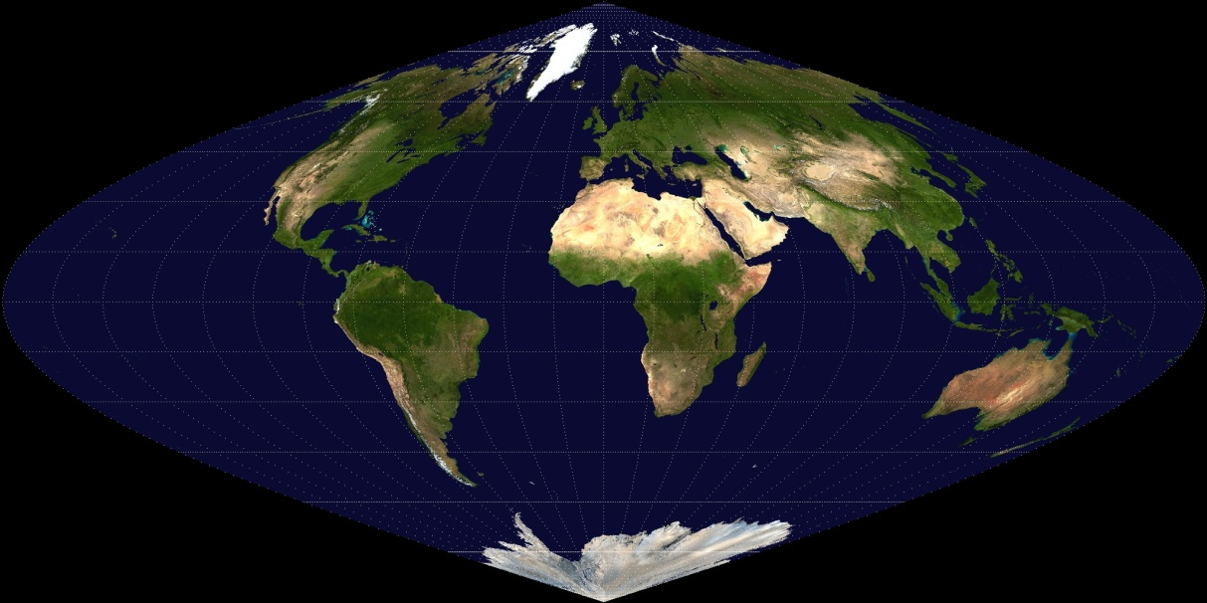
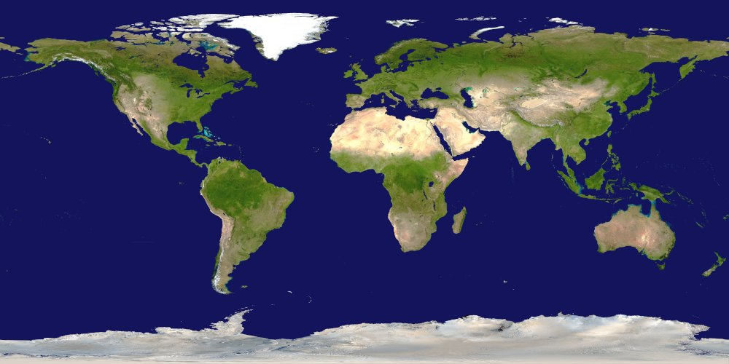
Map Projection
Sinusoidal
a pseudo cylindrical equal-area map projection
WGS84
latitude, longitude pair coordinates in degrees with Greenwich as the central meridian

Slide 12
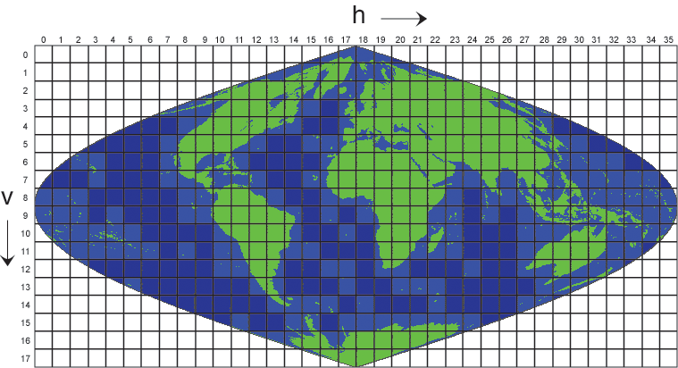

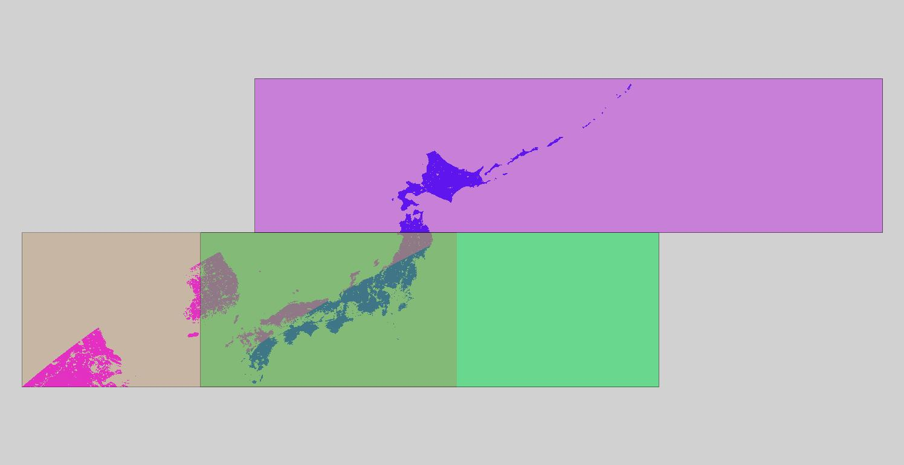

Mosaic

Slide 13

File Formats
HDF : Hierarchical Data Format
HDF4 and HDF 5
HDF-EOS : Hierarchical Data Format – Earth Observing System
HDF-SDS : Hierarchical Data Format – Scientific Data Set
GeoTiff, JPEG2000 etc

Slide 14
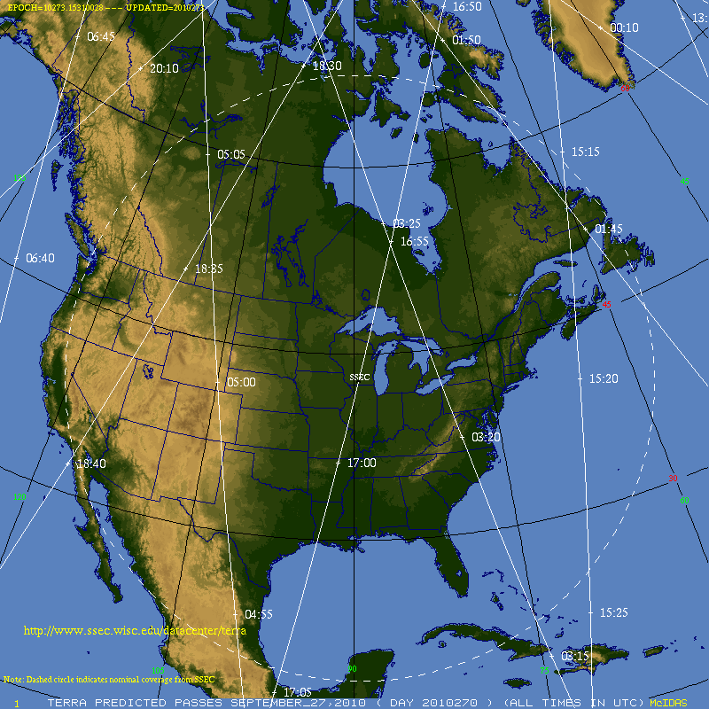
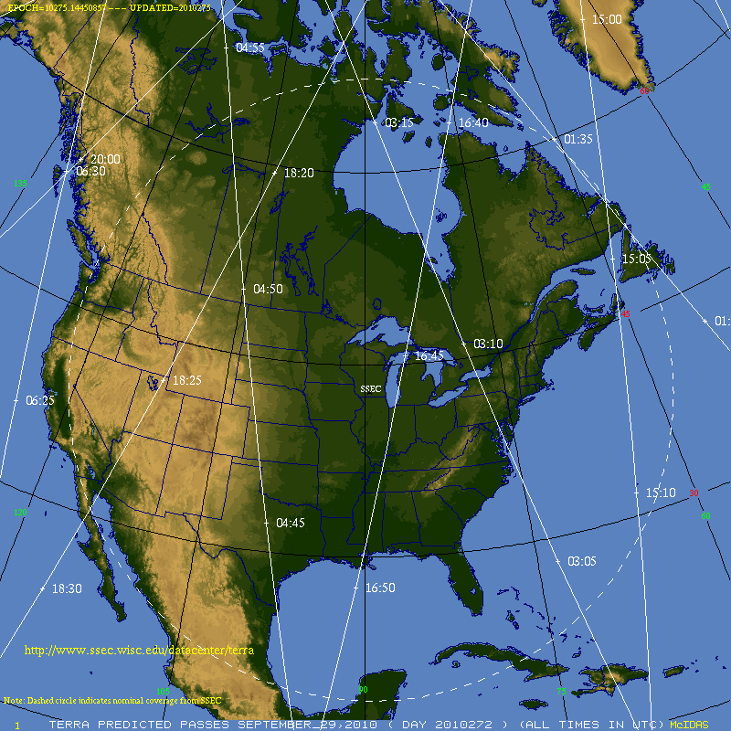
Overpass time
- 27th September 2010 pass area between 16:55 – 17:00
- 29th September 2010 pass area on 16:45

Slide 15

Traditional Workflow
Loop tasks depend on number of stations
Host
Host
Satellite
Product
Satellite
Overpass time
Ground Measurement Data
Loop tasks depend on study period
Acquisition and Manipulation
Downloading
Transform format
Extract data at Station location
Acquisition and Manipulation
Downloading
Transform format
Extract data at Satellite overpass time
Analysis
Validation
Evaluation correlation
Statistical analysis

Slide 16

Satellite Field Integrator (SFI)
Design to reduce the onerous tasks of
Data gathering
Manipulating
Processing
Supports heterogeneous data formats in both remote sensing and sensor observation data
Scalability to handle the increasing number of datasets currently available.
Offers a robust, on-demand processing service

Slide 17
Open Geospatial Consortium (OGC)
Open Geospatial Consortium (OGC)
Non-profit, international voluntary consensus standards organization
Industry, government, and university members
Over 406 members worldwide – over 30 countries & 5 continents
186 European members
50 Asia-Pacific members - Japan, Republic of Korea, Australia, China, Taiwan and etc

Slide 18
What makes a standard “Open”?
Available – Anyone is allowed to read and implement the standard.
No Royalties – Free to implement without paying hefty licensing fees or royalties.
Not controlled by a single vendor - Maximizes end-user choice and makes the market more competitive with no lock-in to a single vendor's implementation
Agreed to by a formal consensus process.

Slide 19

Standards in real world Electrical Plugs (and voltage!)
Electronic devices need standardized access to electrical power.

Slide 20
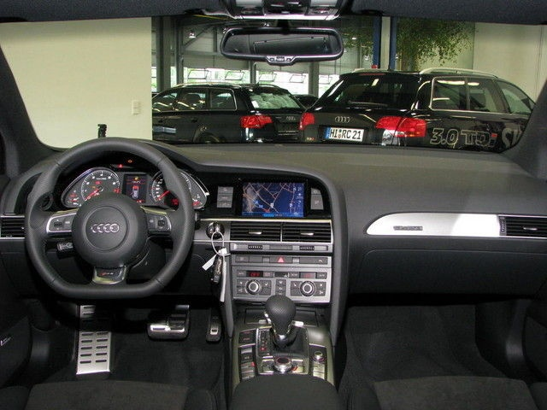
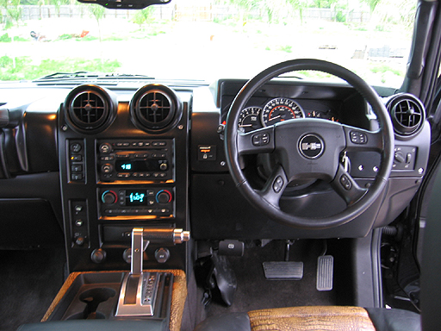
Standards in real world
Left hand drive
Right hand drive

Slide 21








No Standards in real world
= 6 =
7 (may be interpreted as 5
by Malaysian or Singaporean
Chinese)
7/8
9
10
Reference http://en.wikipedia.org/wiki/Chinese_number_gestures

Slide 22


World without standard

Slide 23




















OGC Alliance Partnerships A Critical Resource for Advancing Standards
… and others
www.opengeospatial.org/ogc/alliancepartners
Notes:
Geospatial interoperability is our mission and our expertise. OGC has alliances with other major standards and professional organizations to assure that geospatial interoperability is consistently addressed across the broader IT community. There is a growing body of internet standards that employ OGC standards (such as OGC Geography Markup Language) to consistently define and address “location” across the internet and wireless.

Slide 24





















Example Member Organizations

Slide 25
Satellite Field Integrator (SFI)
The development is based on various open standards of OGC Web Service specifications such as
Web Mapping Service (WMS)
Web Coverage Service (WCS)
Sensor Observation Service (SOS)
Web Processing Service (WPS)

Slide 26

SFI Framework
GetObservation
GetFeatureInfo
Client
GetCoverage
GetFeatureOfInterest
Execute
JSON/PNG/CSV
GetMap
SOS
WPS
WMS, WCS
Evaluation of Relationship process
Least Squares Fitting process
Calculating Estimated Air Temperature process
R
rpy2
GRASS GIS
GDAL
Node
Source
LiveE! Sensor Node
…
…
…
…
MODIS Dataset

Slide 27
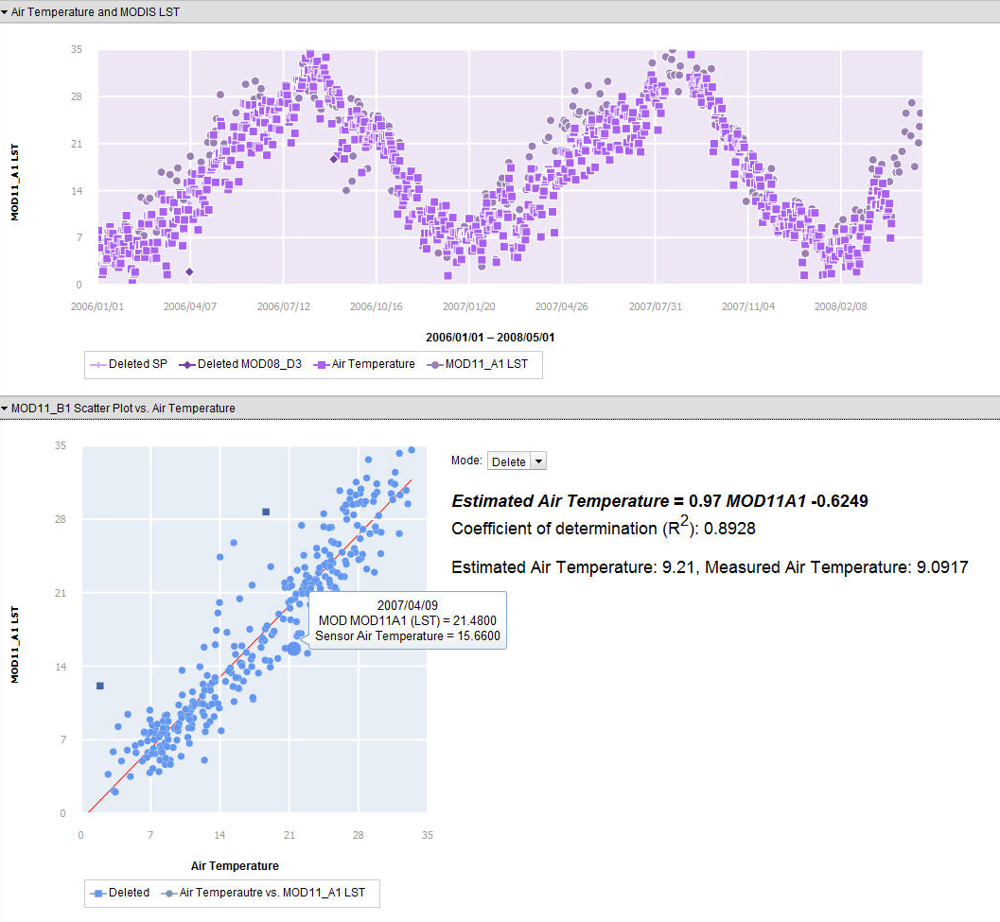
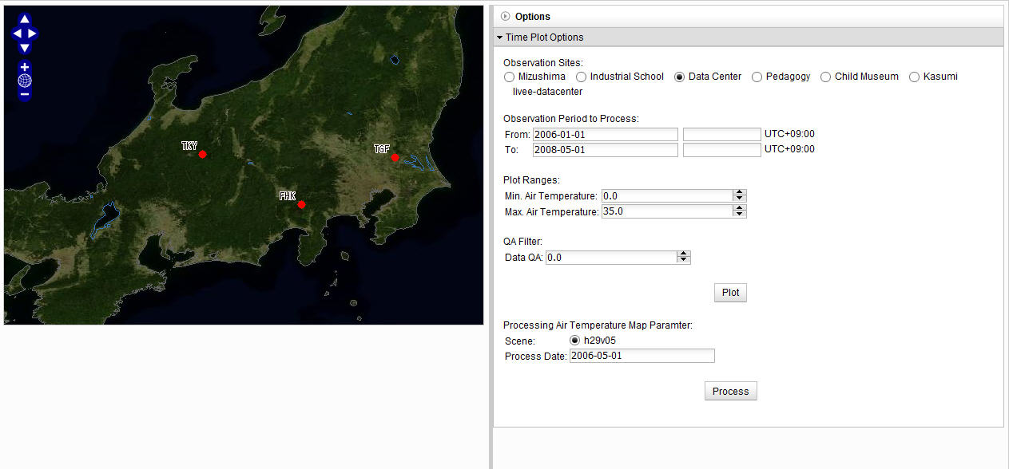
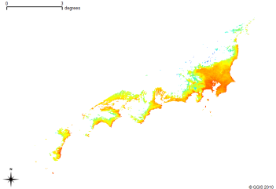

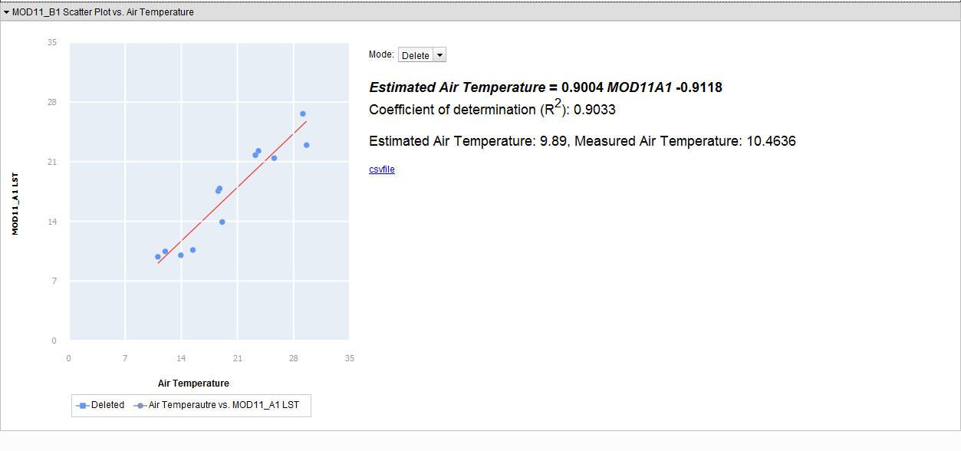
Prototype System
Air Temp. Map
Scatter plot &
Evaluation equation

Slide 28
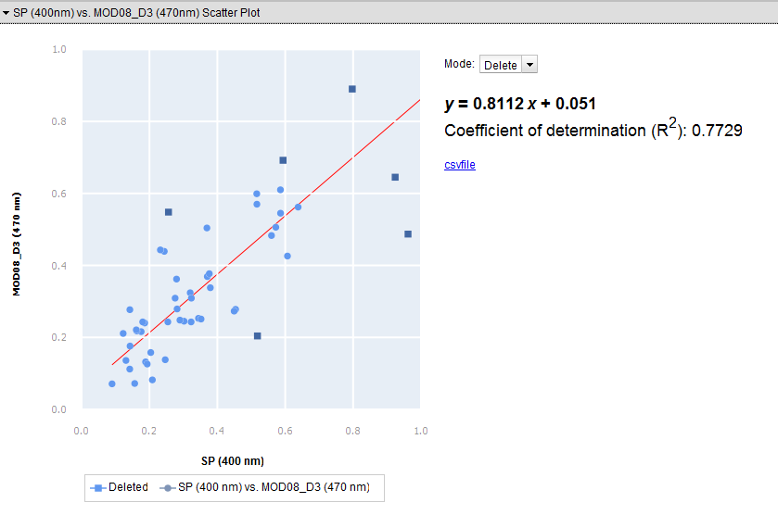
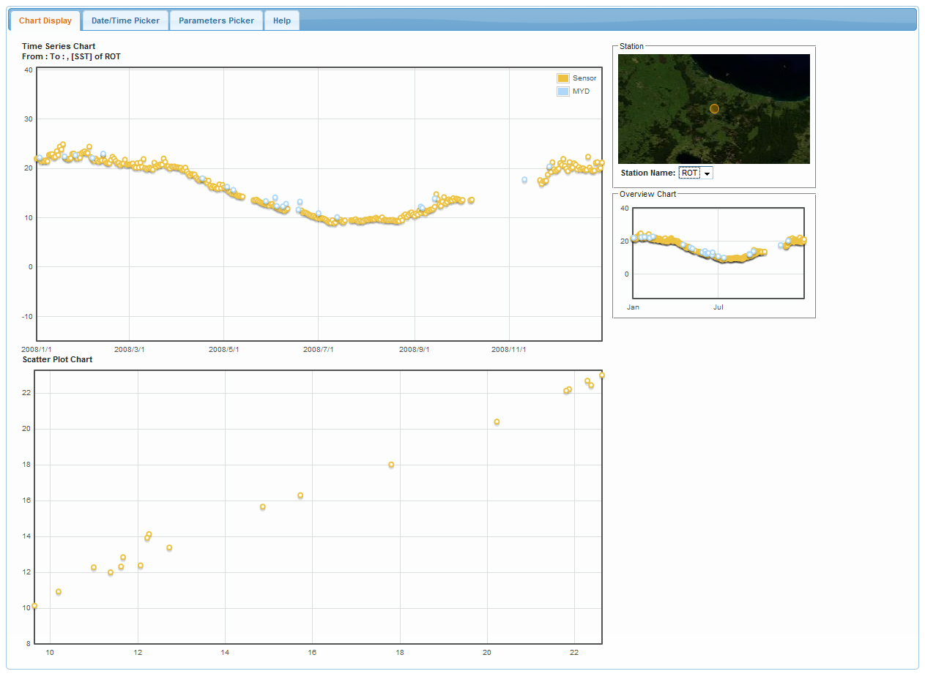
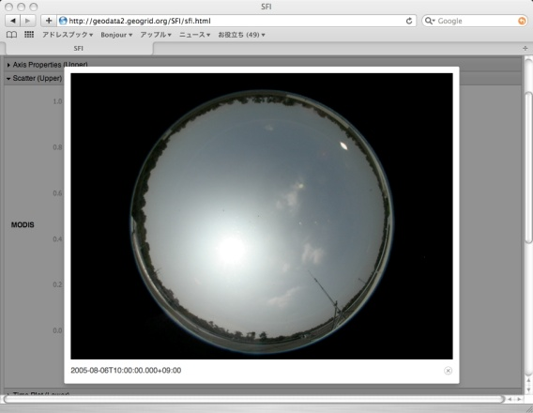
Various Applications
Sea Surface Temperature
Aerosol Optical Depth

Slide 29
AMeDas
AMeDas : Automated Meteorological Data Acquisition System
High-resolution surface observation network by Japan Meteorological Agency
Wind direction, Wind peed, Precipitation, types and base heights of clouds, Visibility, Air temperature, Humidity, Sunshine duration and air pressure.

Slide 30
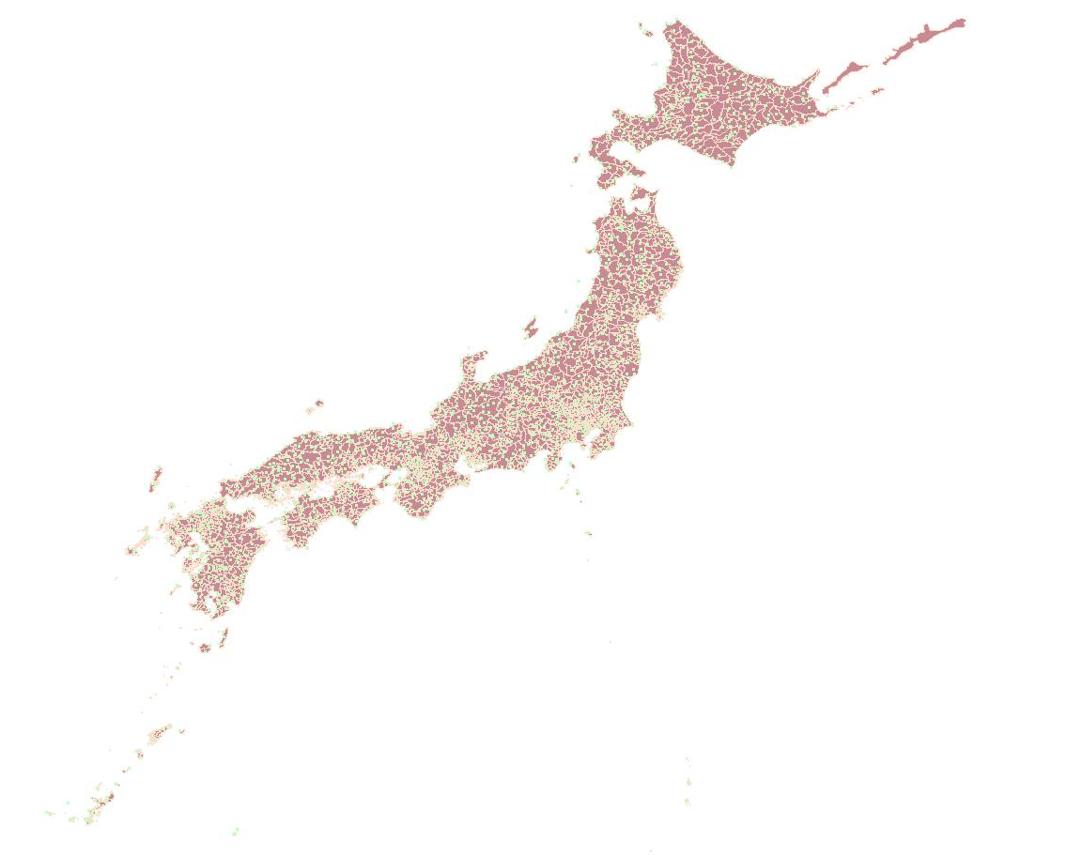
AMeDas
1,300 stations
Located at
an average interval of 17 km
Every 10 minute

Slide 31

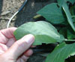
Gross Primary Productivity
MOD17 GPP
GPP = FPAR x LUE
Light, Tree
Min (Temperature)
Water availability
GPP : Gross primary productivity
FPAR : Fraction of absorbed photosynthetically active radiation
LUE : Empirical light use efficiency factor (gCMJ−1)

Slide 32

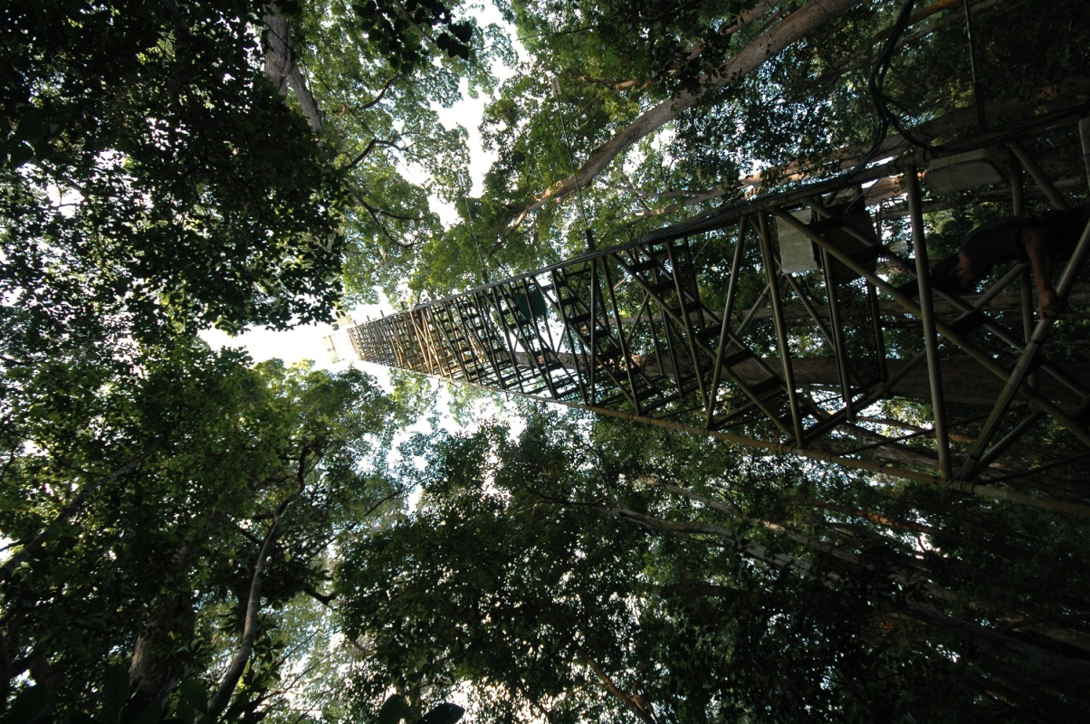

Flux tower
Sakaerat (SKR), Thailand
- Tropical seasonal evergreen forest

Slide 33
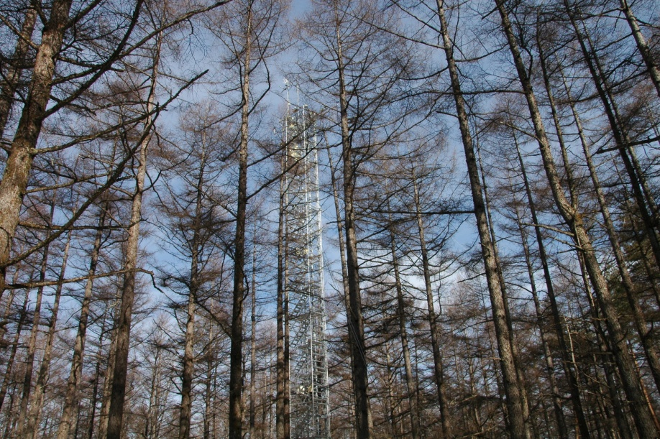
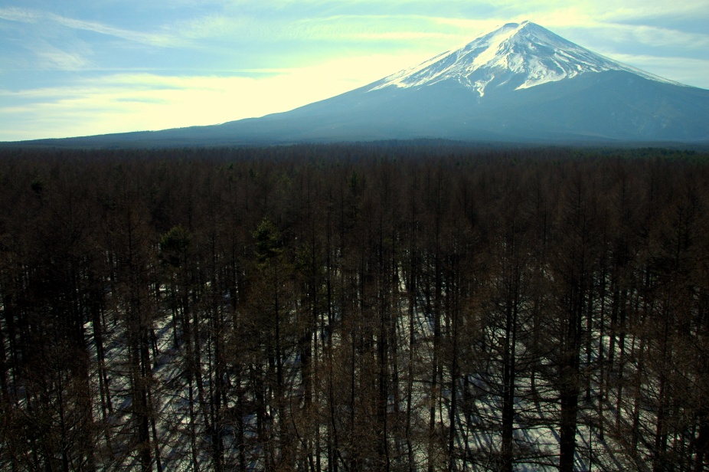
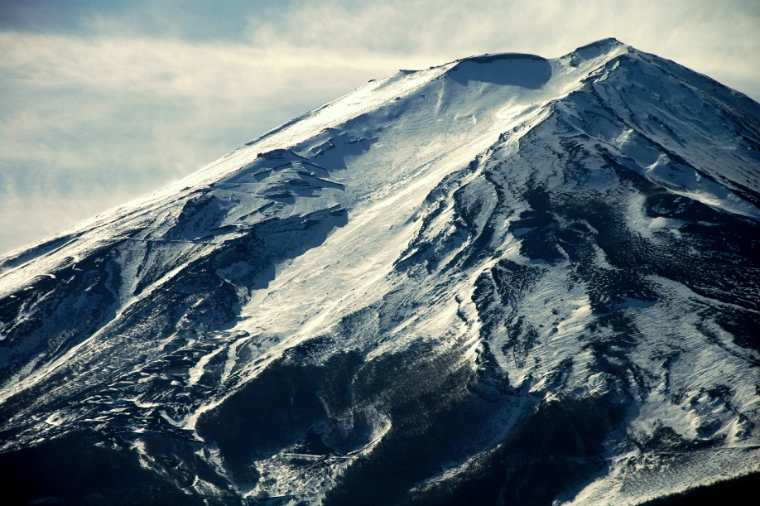
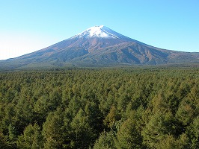
Flux tower
Fuji Hokuroku(FHK), Japan
- Broad leaved plants

Slide 34
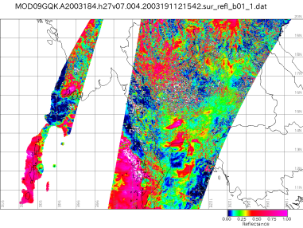
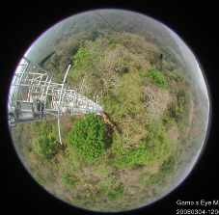
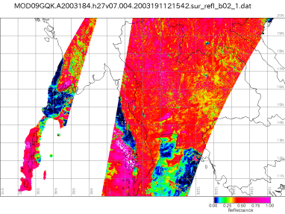
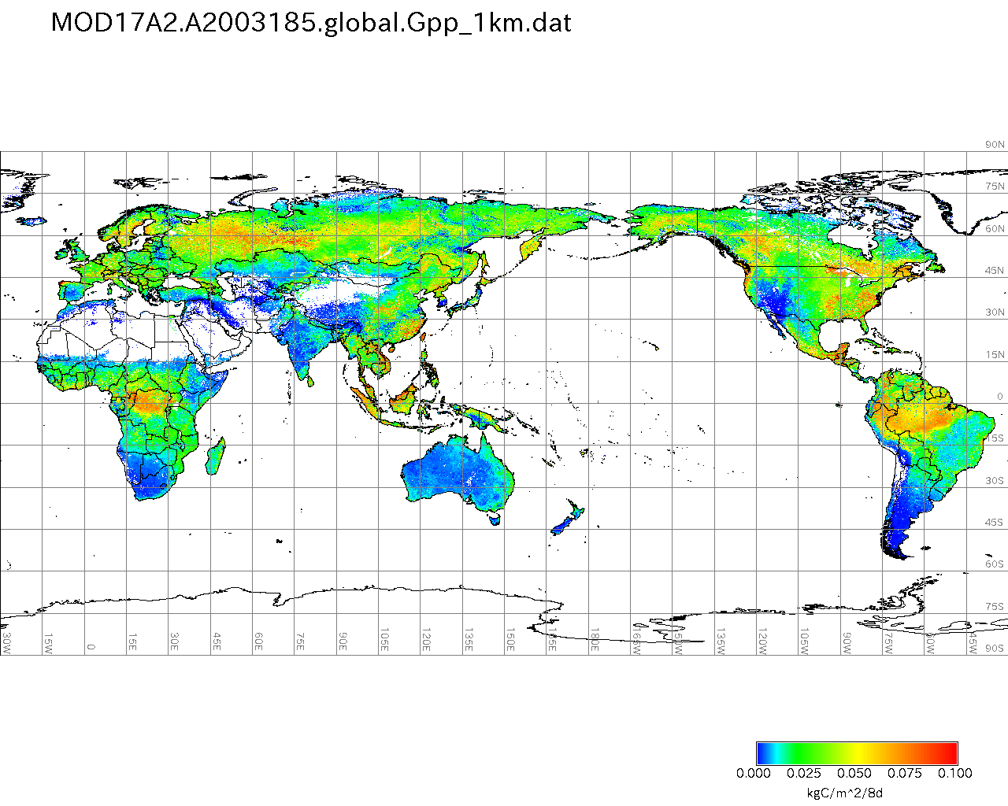
Field Observation data
(Primary production, daily)
MOD09, MOD17a2
→ Vegetation Index （EVI，NDVI）
→ GPP
Saigusa et al. (2008), AFM
Satellite / Field data study
Applying to same forest type
for GPP map.
・The prototype system will done with observation in Japan, Taiwan and Thailand.
・The success of study will extend sensor network to regional and global FLUX group.
(Nagai et al., submitted to IJRS)

Slide 35
Conclusions
Comprehensive web-based GIS system framework enabled
Based on various open standards of OGC specifications
Assimilation of sensor observation data and satellite image
Wider area, More accuracy, Reasonable cost
Minimal effort by overcoming the need for
Complex workflow, high skills requirement, and expensive facilities
HPC & Cloud for Geo Science
Source : Spatial and Temporal
Cost : Disk Space, Network, Processing Power etc.

Slide 36


